Slide 1


Day 02
contact@anubhavtrainings.com
ABAP RESTFUL APPLICATION PROGRAMMING

Slide 2

Agenda – Day 02
Introduction to CDS Views Basics
Introduction to CDS entities
Describing AMDP with Use Case
Table function
Service Definition & Service Binding
Introduction to SAP Business Application Studio
Notes:
Creating OData Service ( Business Service)
Introduction to Fiori Elements
Free style v/s Fiori Elements App
Developer persona – Fiori Elements
List Report Object Page App
Developing Read-Only List Reporting Apps
UI Annotation
Adding Search Capabilities
Adding Metadata Extension

Slide 3

Code To Data Paradigm
ABAP System
CDS Views
NW 7.4 SP6
Any DB
AMDP/Table Function
7.4SP6, 7.5
HANA DB
HANA Views
SQL Script procedure and function
www.anubhavtrainings.com

Slide 4
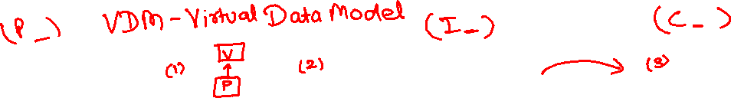
Why we need views in ANY SOFTWARE
Hide complexity – Imagine we have a ERP system, usually data in ERP is spread across MULTIPLE tables. Reading the data with Query becomes complex and error prone. We code VIEWS with all selections, conditions, and associations (joins). It provides data from functional point of view.
Security – We do not want to give direct access to DB tables, because tables are prone to attacks and security breach. Hence we create views, by masking (hiding), projections of the relevant data for the business use case. We additionally add ROW level security.
Modularization – We can develop complex functionalities by small size modules. Which calls and orchestrates between each other. It brings reusability and reduces redundancies.
In context of SAP CDS, we have annotations, framework consumptions, ease of development, support for tools, support for multiple use case, industry standard, inherent documentation.
Private views
Interface views
Consumption views
Developers only access to be used within other views, direct consumption should be prohibited.
Basic
Composite
Used for final consumption built on top of interface views.
They are reusable views can be consumed for any purpose, as they build a bridge between tables. Basic views are pure master, transaction data but composite views are combination of master and transaction data.
www.anubhavtrainings.com

Slide 5
Use Case
We want to develop a set of views which usages our custom data model to expose sales data for each customer and product.
Consumption 1
Total sales per customer
Composite
Total sales per product
https://help.sap.com/docs/BTP/5371047f1273405bb46725a417f95433/2d3a05e516374108b5881840267a13b2.html
Composite
Interface Sales
Interface Customers
Interface Products
I_Country
BusinessPartner
Sales Order Header
Sales Order Item
product
www.anubhavtrainings.com
I_Currency

Slide 6
Creating CDS View
ZATS_00_C_SOFTSALES
ZATS_00_I_BP
ZATS_00__I_SALES
ZATS_00_SO_I
0..1
ZATS_00_BP
0..1
ZATS_00_I_SALESHDR
ZATS_00_P_PROD
0..1
ZATS_00_SO
ZATS_00_Product
Exercise
Create CDS View According to VDM

Slide 7




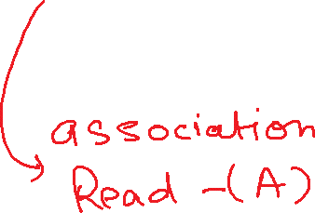
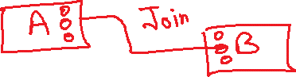





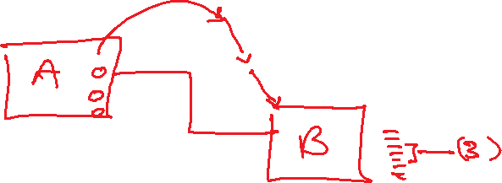
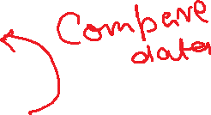




Slide 8
CDS Entity
CDS entity is EXACTLY like CDS Views but with
optimized performance,
A single object for all purpose basically no more 3 names
No need to create DDIC view
The HANA view name will be same as CDS entity Name
Exceptions
CDS entities does not support BOPF integration
www.anubhavtrainings.com

Slide 9
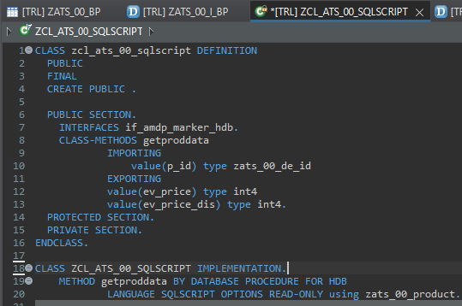
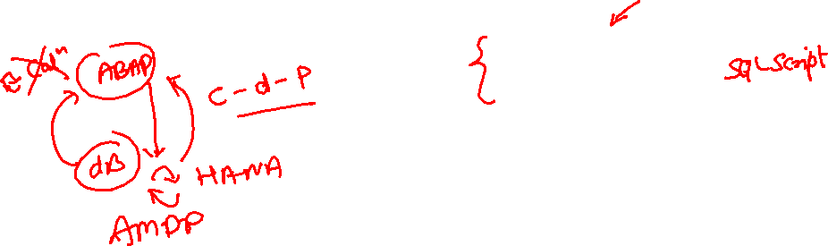
Describing AMDP
ABAP Managed Database Procedures (AMDP) are the preferred way for developing SAP HANA DB procedures on the ABAP platform. Since ABAP Managed Database Procedures are implemented as methods of a global ABAP class, the editing environment for AMDP is the ABAP class editor.
Requirement 1: Pass the product id, system should calculate the discounted price and return
actual and discounted price.
There are 2 types of SQL Script contains:-
Procedure - can have multiple return values
Function - always have one return value
Exercise
Create AMDP

Slide 10
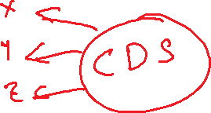
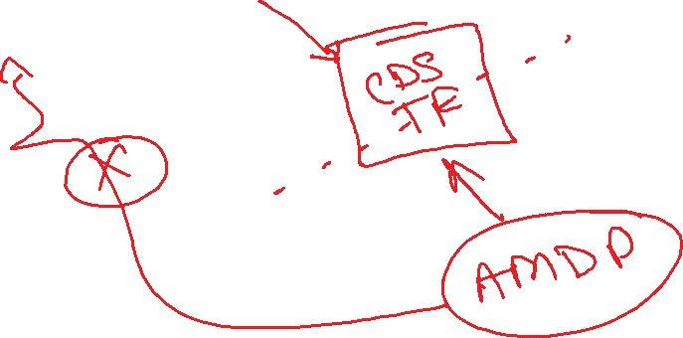


Slide 11
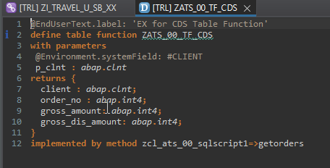
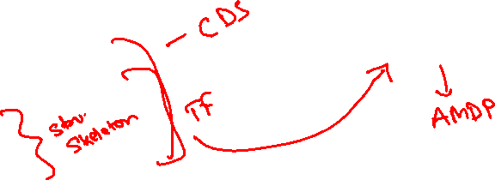
Creating Table Function
A CDS table function is defined using the ABAP CDS statement DEFINE TABLE FUNCTION and can be used as the data source in Open SQL read statements.
Each CDS table function includes the following components:
The actual CDS entity of the table function that is generated in the ABAP Dictionary
The CDS table function implementation (ABAP class library)
Requirement 2: return all the sales order no, amount (actual), discounted amount of sales orders]
Exercise
Create Table Function

Slide 12
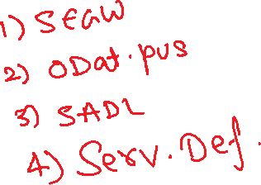
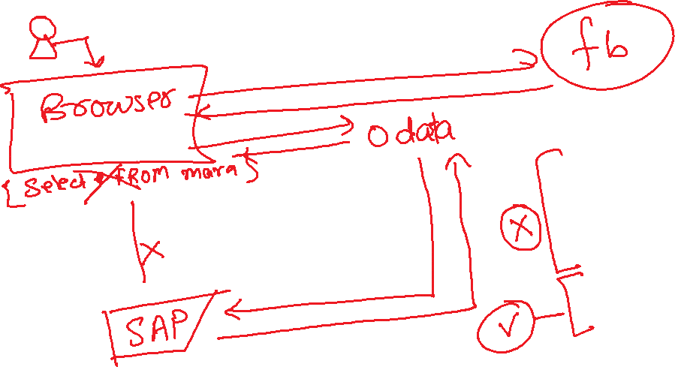
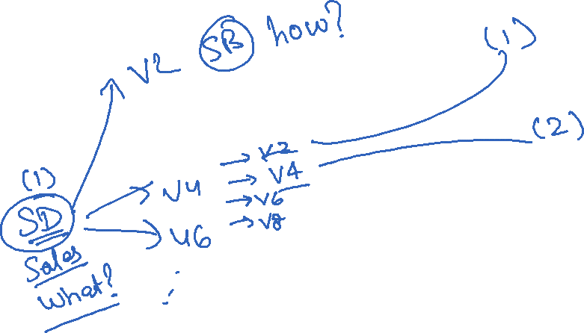
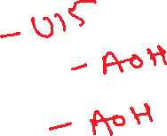
ODATA – Open Data Protocol by Microsoft. SAP adapted Odata protocol in 2012.
How to expose data over HTTP using REST Service.

Slide 13
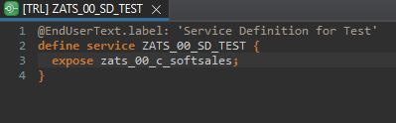
Service Definition
The service definition is a projection of the models and related behavior that you want to expose. In a service definition, you define the OData service to determine which CDS entities are part of the service. This service is then bound to a protocol and to either a UI technology or an A2X service by a service binding artifact. A service definition can be integrated in various protocols without any reimplementation.
Exercise
Service Definition

Slide 14
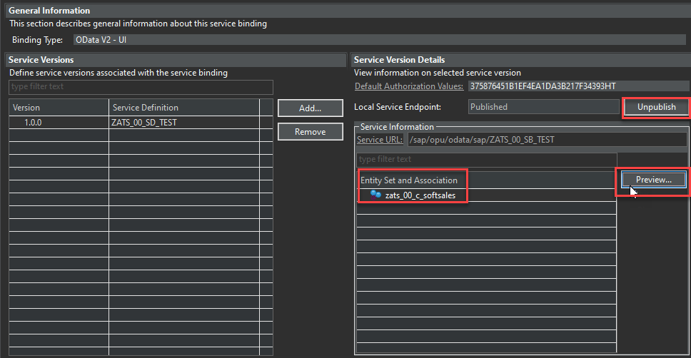
Service Binding
A service binding implements the protocol that is used for the OData service. It uses a service definition that projects the data models and their related behaviors to the service.

Slide 15
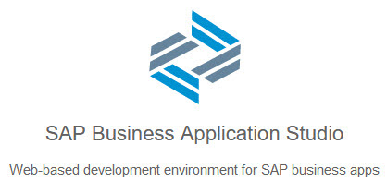
BAS Introduction
SAP Business Application Studio is a new SAP Business Technology Platform (BTP) service that offers a modern development environment tailored for efficient development of business applications for the SAP Intelligent Enterprise.
SAP Business Application Studio provides a tailor-made development environment for various development scenarios, such as SAP Fiori, SAP S/4HANA extension, and Workflow. With each of these scenarios, you can create different types of applications.
These tools cover the end-to-end development cycle:
Clone an existing project with a Git client or create new project using templates.
Use editors for SAP-specific technologies.
Easily test your application on your dev space while consuming services from remote sources.
Build and deploy the application as a multitarget application (MTA).

Slide 16
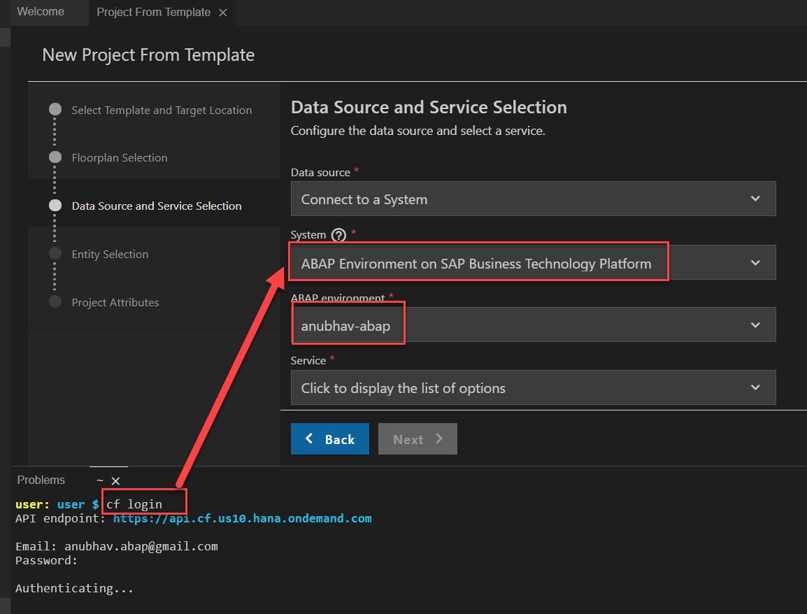
Creating Fiori App on BAS
Creating Fiori App on BAS Using Service on Top of CDS Model.
First Login Cloud Foundry ( cf login ).
Select System ABAP Environment on SAP BTP.

Slide 17
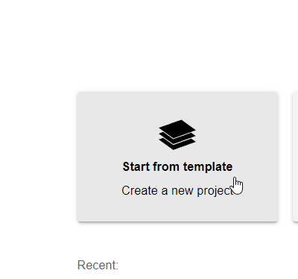
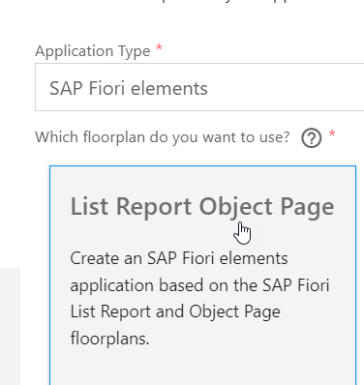
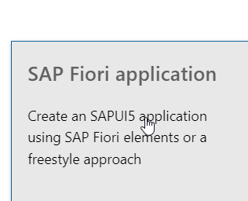
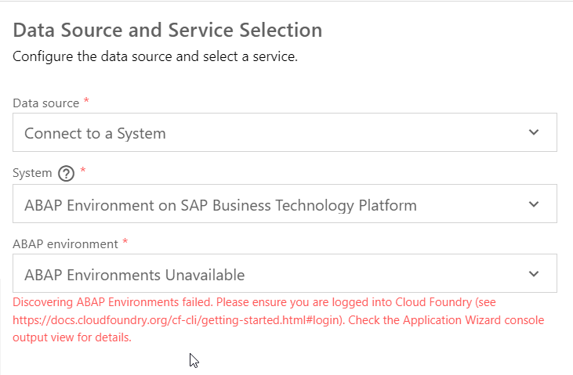

Slide 18
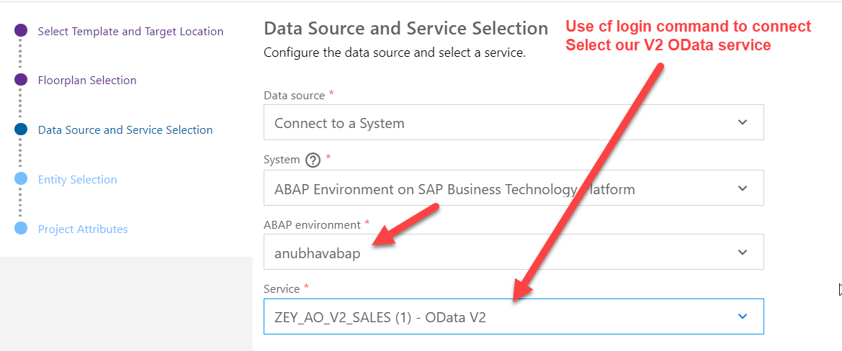
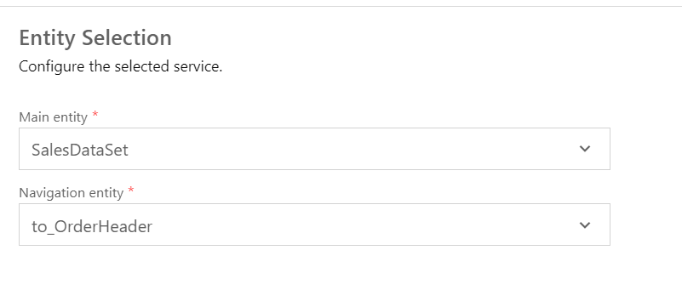

Slide 19
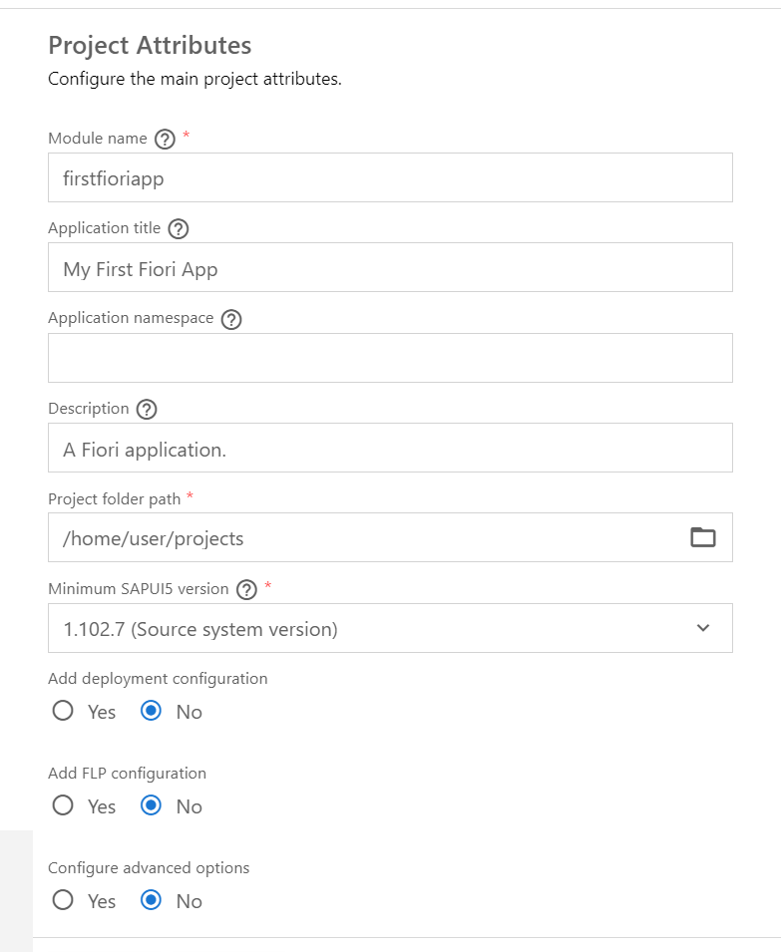

Slide 20
AMDP CDS Table Function
AMDP when called, creates a procedure in HANA
We can have multiple input and output parameters
We can use AMDP for write operations
We cannot join an AMDP with CDS views or entities
TF when called, it creates a Table Function (UDF) in HANA
We can have multiple input but the output is ONLY one
Always read only
Can be used as join/association with another CDS views

Slide 21

End of Day 02
Trainer: Anubhav Oberoy

Slide 22

Trainer: Anubhav Oberoy

Slide 23
THANK YOU
If you cannot do
great things, do small things in a great way.
Anubhav Oberoy
https://www.anubhavtrainings.com

Slide 24


We’re committed to empower you to be
Most Desirable Resource
through powerful training solutions.
We build the workforce of the future.
250+
Corporate Clients
30,000+
Learners Trained
25000+
Learners Placed
FREE WEBINARS
Sign up for free webinars with industry experts every fortnight!
Enroll Now!
Contact us today!
https://anubhavtrainings.com/

Slide 25




More from AnubhavTrainings.com

